Slide 1
Exoplanet Data
Import Data: 26832 rows x 299 Columns
Filter = What questions do you want answered
Sergio Gonzalez
My questions:
- How has exoplanet discoveries changed through time
Who is the one doing all the discoveries
Preferred discovery method

Slide 2
Filter and Clean
pl_name | disc_year | discoverymethod | disc_facility | pl_masse | pl_dens
0 | 11 Com b | 2007 | Radial Velocity | Xinglong Station | NaN | NaN
1 | 11 Com b | 2007 | Radial Velocity | Xinglong Station | NaN | NaN
2 | 11 UMi b | 2009 | Radial Velocity | Thueringer Landessternwarte Tautenburg | NaN | NaN
3 | 11 UMi b | 2009 | Radial Velocity | Thueringer Landessternwarte Tautenburg | NaN | NaN
4 | 11 UMi b | 2009 | Radial Velocity | Thueringer Landessternwarte Tautenburg | NaN | NaN
5 | 14 And b | 2008 | Radial Velocity | Okayama Astrophysical Observatory | NaN | NaN
6 | 14 And b | 2008 | Radial Velocity | Okayama Astrophysical Observatory | NaN | NaN
7 | 14 Her b | 2002 | Radial Velocity | W. M. Keck Observatory | NaN | NaN
8 | 14 Her b | 2002 | Radial Velocity | W. M. Keck Observatory | NaN | NaN
9 | 14 Her b | 2002 | Radial Velocity | W. M. Keck Observatory | NaN | NaN
10 | 14 Her b | 2002 | Radial Velocity | W. M. Keck Observatory | NaN | NaN
Found necessary columns (shifted left are the names)
Mass and density… are NaN ☹
Count all not NaN
… Can we still use this sample
2440 1407 26832 26832 26832 26832

Slide 3
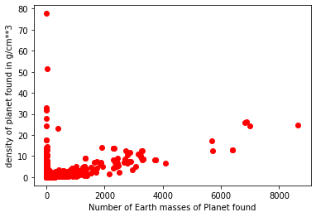
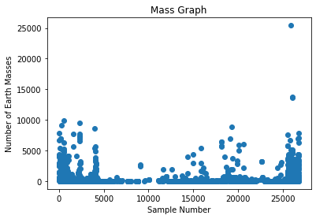
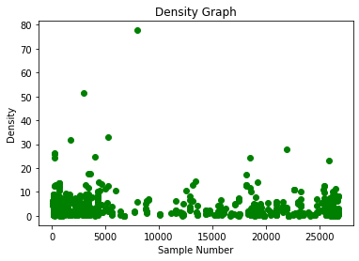
To do or not to do
Set Index as x – axis (range(len(r))…. Any Correlations
the mean planet mass is 594.7740537991812
the mean planet density is 2.2428910660980845
the standard deviation for planet mass is 1298.9969580169177
the standard deviation for planet density is 4.1099244901982255
the max planet mass is 25426.4
The max planet density is 77.7
The min planet mass is 0.02
The min planet density is 0.01
From the values we do have, NaN values not considered when using mean, std, etc

Slide 4
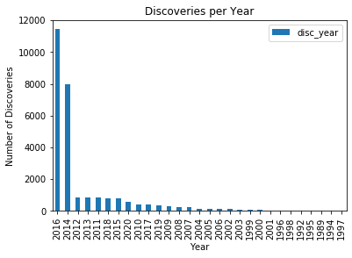
The other data…
Year # of Discoveries
2016 11444
2014 7983
2012 850
2013 841
2011 832
2018 817
2015 763
2020 545
2010 422
2017 393
2019 337
2009 314
2008 248
2007 233
2004 145
2005 126
2006 118
2002 115
2003 64
1999 60
2000 58
2001 43
1996 33
1998 31
1992 6
1995 4
1989 3
1994 2
1997 2
Count - up all discoveries per year -> 2016 we had the most
Sorted by largest to smallest, Next would be to sort by year for trends

Slide 5
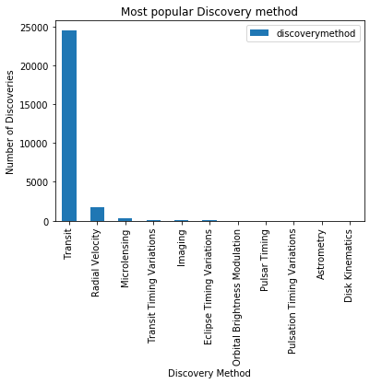
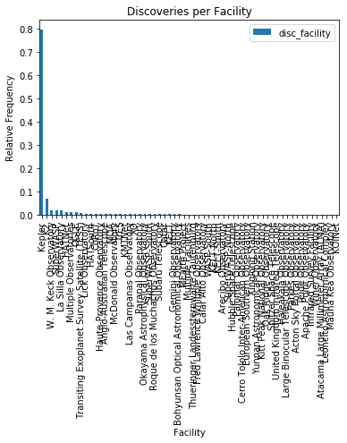
discovery method
Transit 24529
Radial Velocity 1741
Microlensing 304
Transit Timing Variations 106
Imaging 100
Eclipse Timing Variations 21
Orbital Brightness Modulation 15
Pulsar Timing 12
Pulsation Timing Variations 2
Astrometry 1
Disk Kinematics 1
Count for the Method of discoveries and for facilities… Transit and Radial velocity favorites
For facilities used relative frequency (kepler)

Slide 6
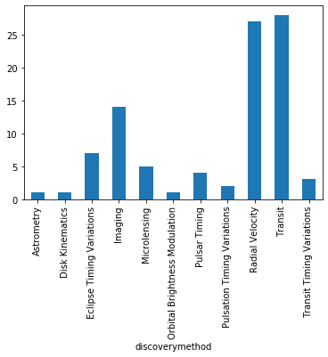
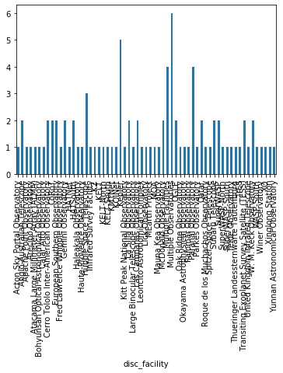
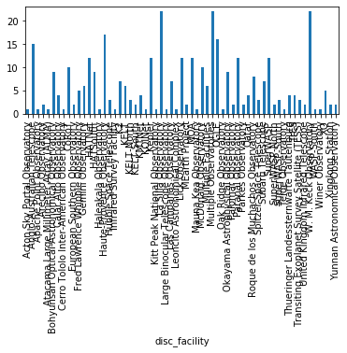
# of unique facilities (y – axis) per method… How many different facilities are using that discovery method
# of unique methods (y – axis) per facility… what facility uses the most discovery methods …hard to read huh…
# of unique years discovered (y – axis) per facility… How many years has facility reported a finding

Slide 7
Difficulties
NaN values (redownload data) / impacts on graphs (Maybe replace with 0 for graphing)
Graph sizes (using subplots_adjust didn’t help, scaling, etc)
Std (1298) Doesn’t make sense so possible error
Summary
Transit and radial velocity most used methods
Average earth mass we found was 594, Jupiter is 318, Super Jupiters are around 635… Average planet we find is bigger than Jupiter!!
(bored work at kepler) most discoveries (not confirmed!!), uses lots of methods
Kepler mission lasted 9 years… would put it towards the top/middle of years in use
More discoveries in 2010 and up than before that time period

